Slide 1
CPSC 4810 Project
An analysis on United States’ County Level Data
Andrew Liu 100390239
Manmeet Kaur
Patrick Ipac 100385706

Slide 2
Merging the Datasets
Variable Selection and Subsetting the Raw Datasets
Data Cleaning
Missing Values
Duplicated Rows
Abnormal Values
Selecting Index Columns and Data Manipulation

Slide 3
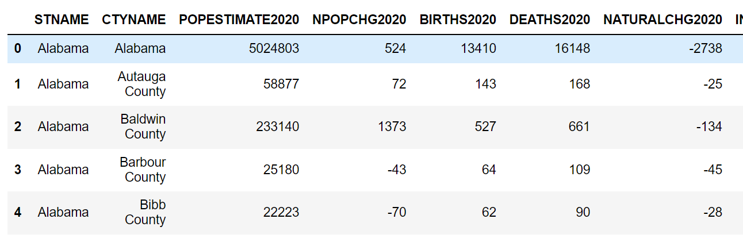
A. The Population Dataset

Slide 4
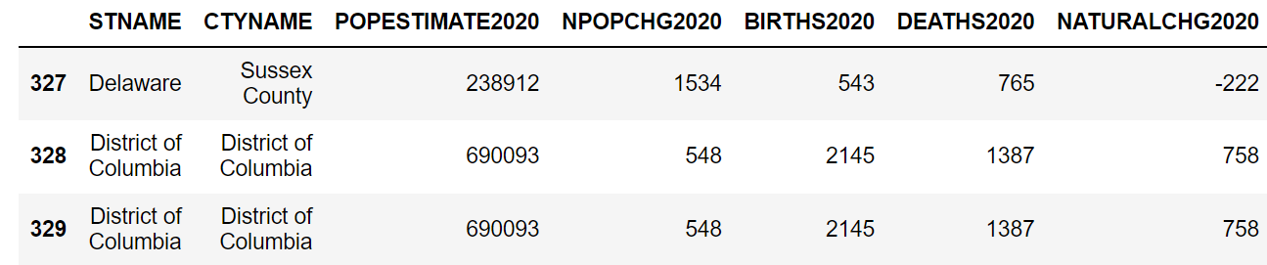
A. The Population Dataset
No Missing Values
Duplicates:

Slide 5
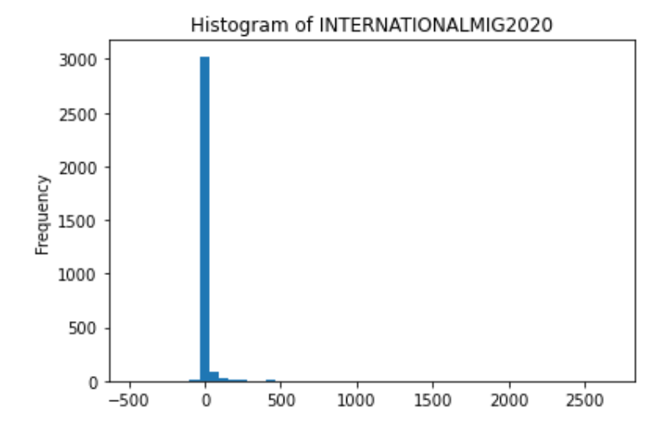
A. The Population Dataset
3. Outlier Values

Slide 6
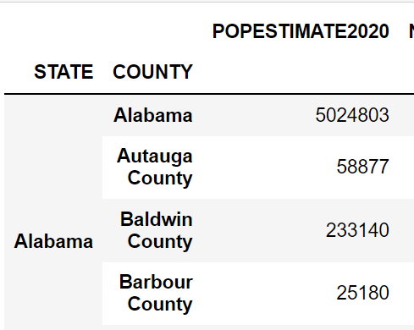
A. The Population Dataset

Slide 7
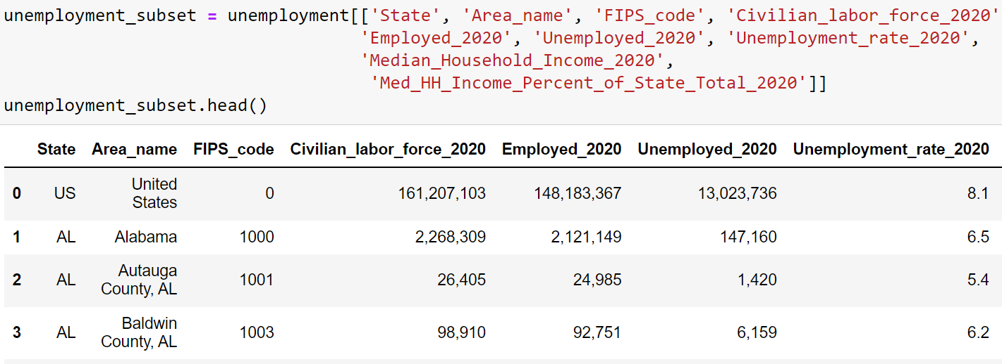
B. The Unemployment Dataset

Slide 8
B. The Unemployment Dataset
Missing Data
If the response is a string, remove the ‘,’ and turn it into an integer
Impute by median (because of national and state values)
Duplicates: None
Outliers: None

Slide 9
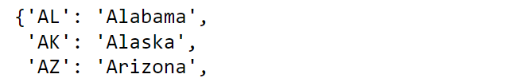
B. The Unemployment Dataset
Index Columns:
Created a new County column
Used string splicing to retrieve county names before ‘,’
Rename corresponding index columns names
Replacing state responses by mapping

Slide 10
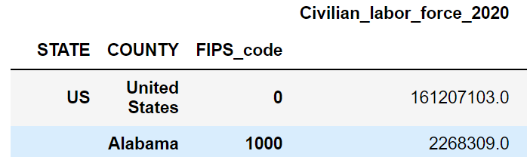
B. The Unemployment Dataset

Slide 11
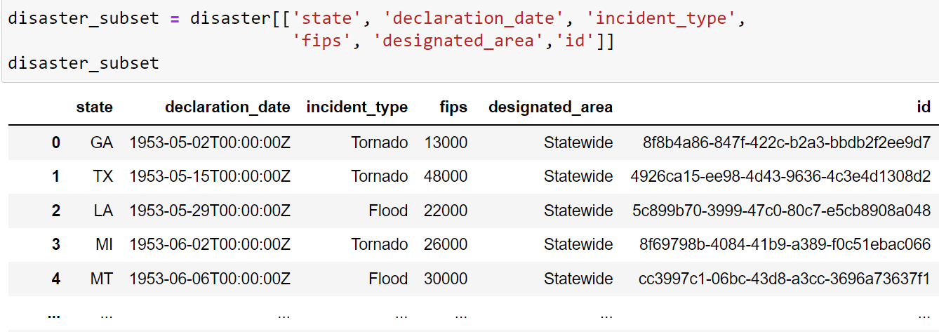
C. The Disaster Dataset

Slide 12
C. The Disasters Dataset
Missing Data: None
Duplicates: None
Outliers: None

Slide 13
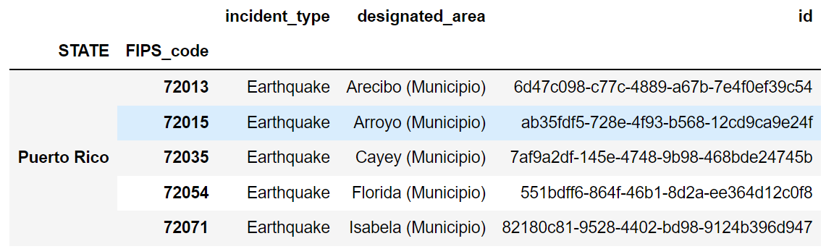
C. The Disasters Dataset

Slide 14
Merging the Datasets by Inner Joins
Dataset | Index Available for Merging
Population | STATE, COUNTY
Unemployment | STATE, COUNTY, FIPS_code
Disaster | STATE, FIPS_code

Slide 15
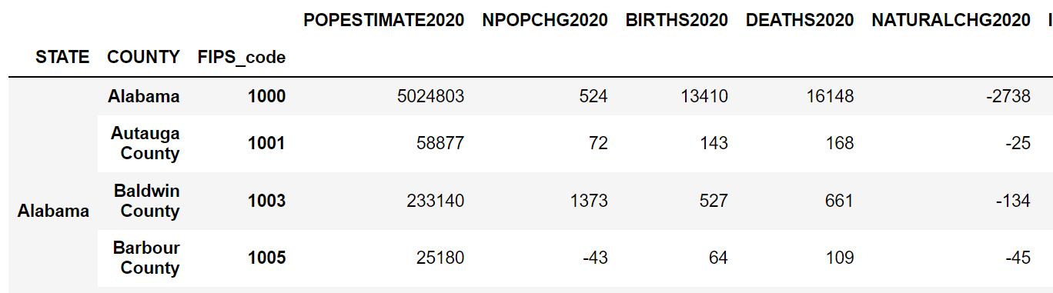
Final Dataset

